Slide 1
Ute Mountain Ute Tribe
Janice Archuleta:
Air Quality Program Manager
Arlyssia Sells:
Air Quality Technician
MAIA-TEMPO Environmental Justice Workshop
August 5, 2022

Slide 2
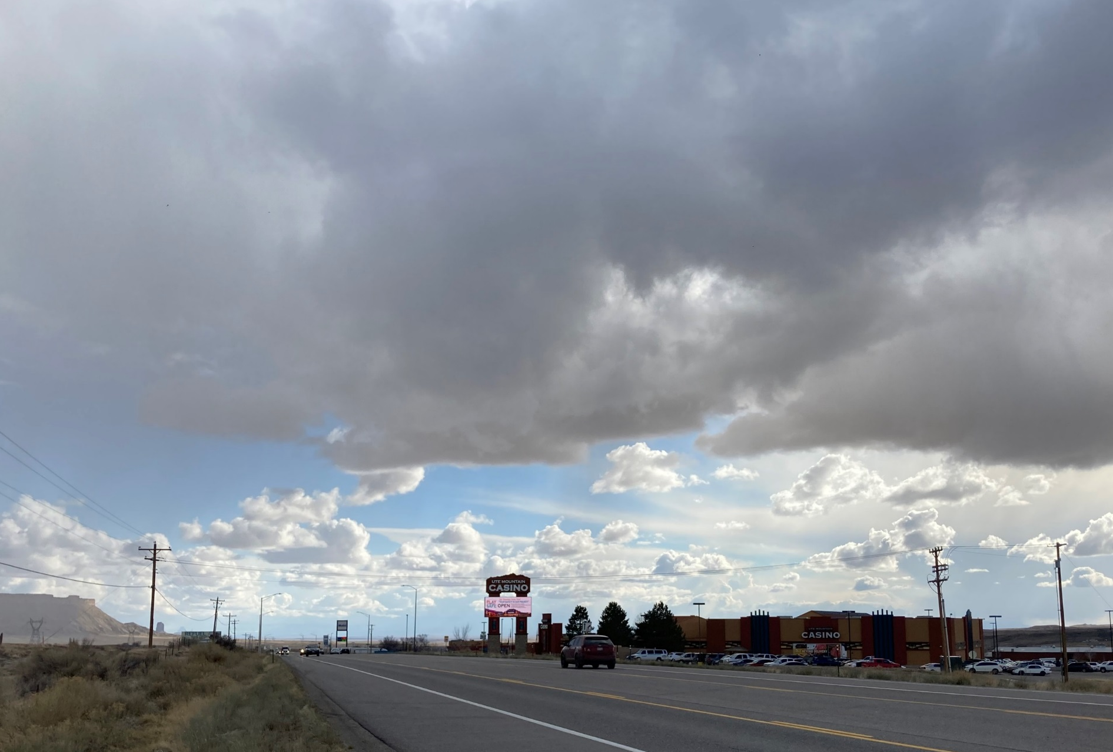
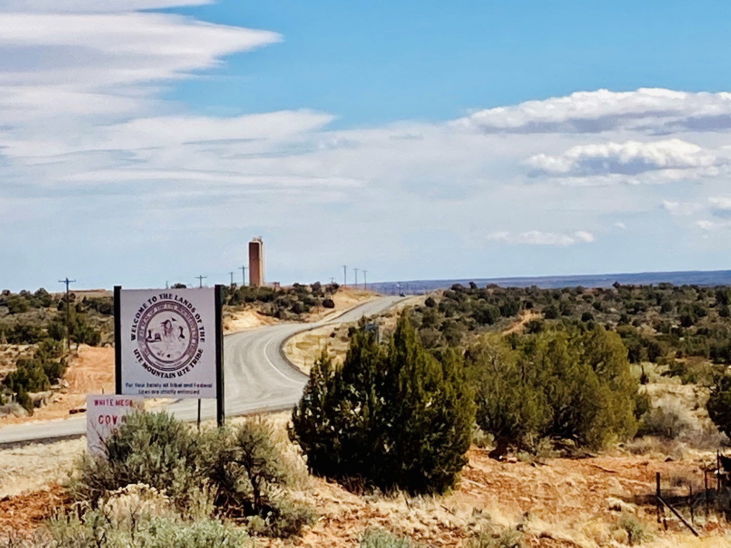
Ute Mountain Ute Tribe
Homeland for the Weeminuche Band – 2,200 members.
Located in extreme southwestern Colorado, with portions extending in southeastern Utah and northwestern New Mexico.
933 square miles in total area of trust land.
43 square miles of fee land (cattle ranching).
Interest in TEMPO datasets
Notes:
You can remove the explanatory text and images of course!

Slide 3
Ute Mountain Ute Tribe
Map:
Ute Mountain
Ute Tribe

Slide 4
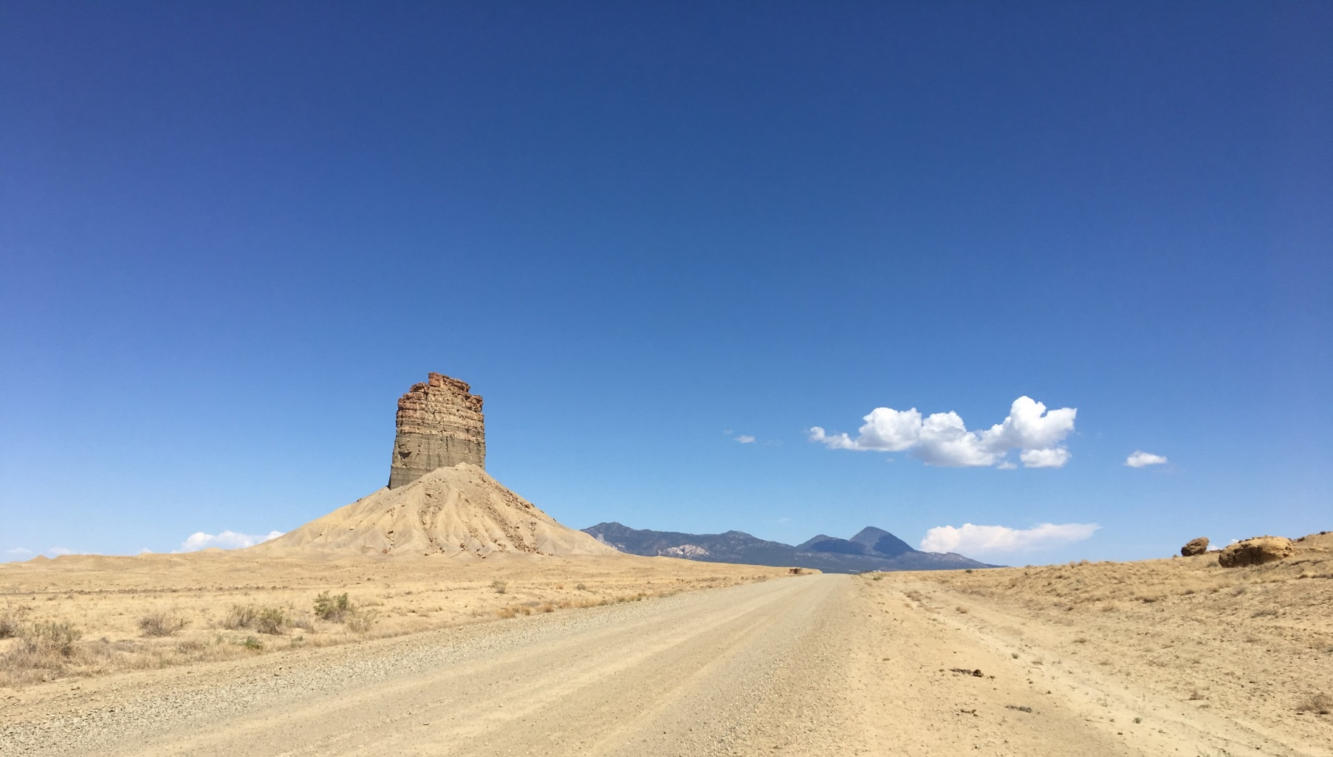
Air Quality Program
Environmental Programs Department of the Ute Mountain Ute Tribe
Mission - Protect Air Quality for the Ute Mountain Ute Community and Lands
Air Quality Program – Funded by EPA
2011 – 2022 Clean Air Act Grant 103
2022 – Environmental Justice Grant
2023 – Clean Air Act Grant 105
2023 – American Rescue Plan Funding

Slide 5
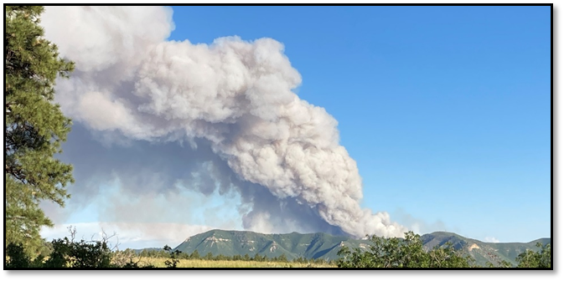
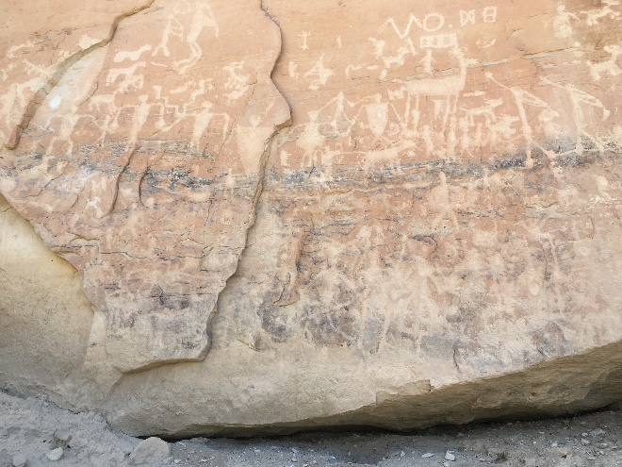
White Mesa Uranium Mill and Mines
Map:
Ute Mountain Ute Tribe and major sources of pollutants/concerns
Cultural Resources – Tribal Park
Oil and Gas Industry
Coal Burning Electrical Generating Power Plants
Notes:
Feel free to change slide headings and so forth

Slide 6
Ute Mountain Ute Tribe
US Recognized Native American Indian Tribe.
Tribal Community is tied to their land and environment by cultural values, traditions, and customs.
The Ute Mountain Ute Tribe is faced with a number of socio-economic hardships, including poverty.
Indigenous/Tribal populations have higher incidences of asthma, diabetes, heart disease, chronic obstruct pulmonary disorder (COPD) than people of non-American Indian/Alaskan Native populations.
Notes:
Feel free to change slide headings and so forth

Slide 7
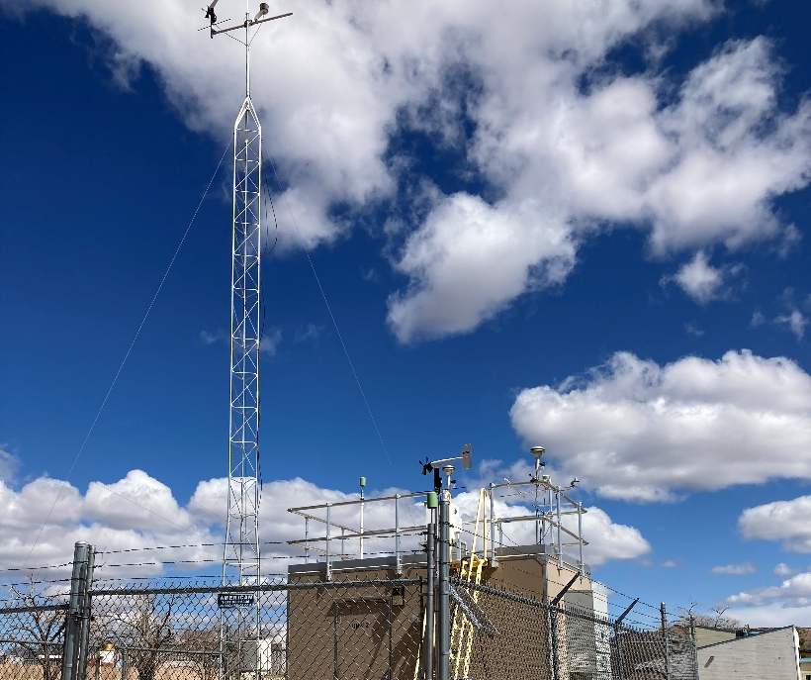
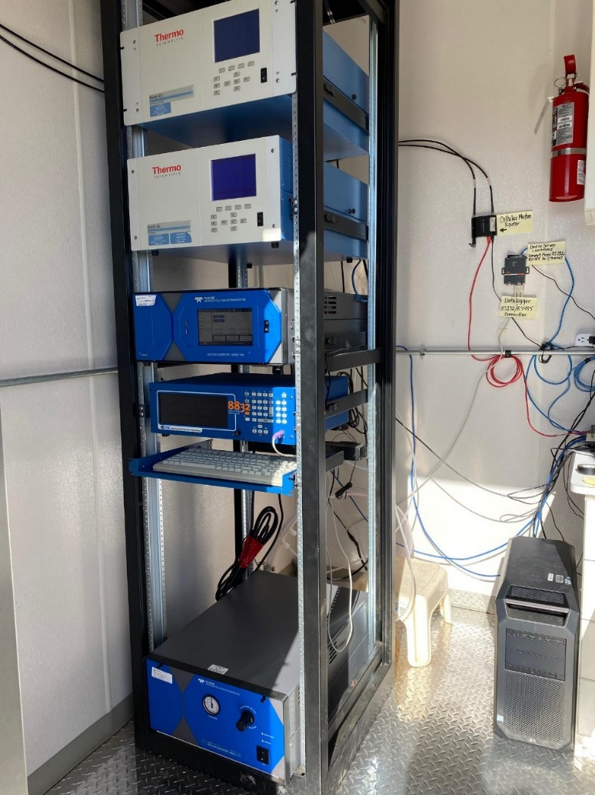
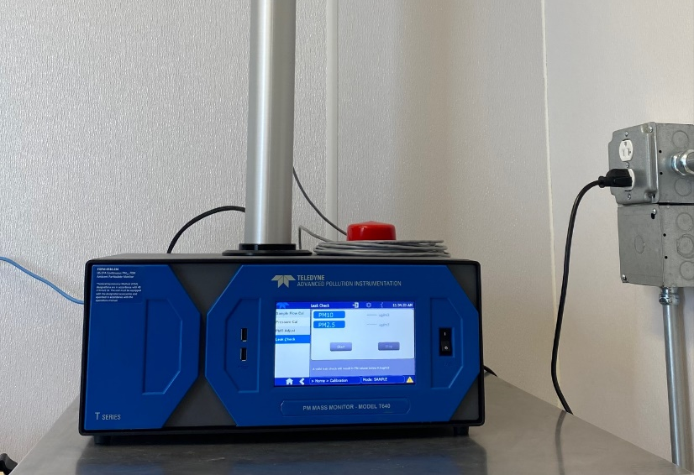
UMUT Air Quality
In Towaoc, CO
Teledyne T640
2.5 (micrometers) Particulate Monitor – Continuous Federal Equivalent Monitor (FEM)
Meteorological parameters
Regulatory Ozone program ThermoScientific 49i Analyzer (since 2019)

Slide 8
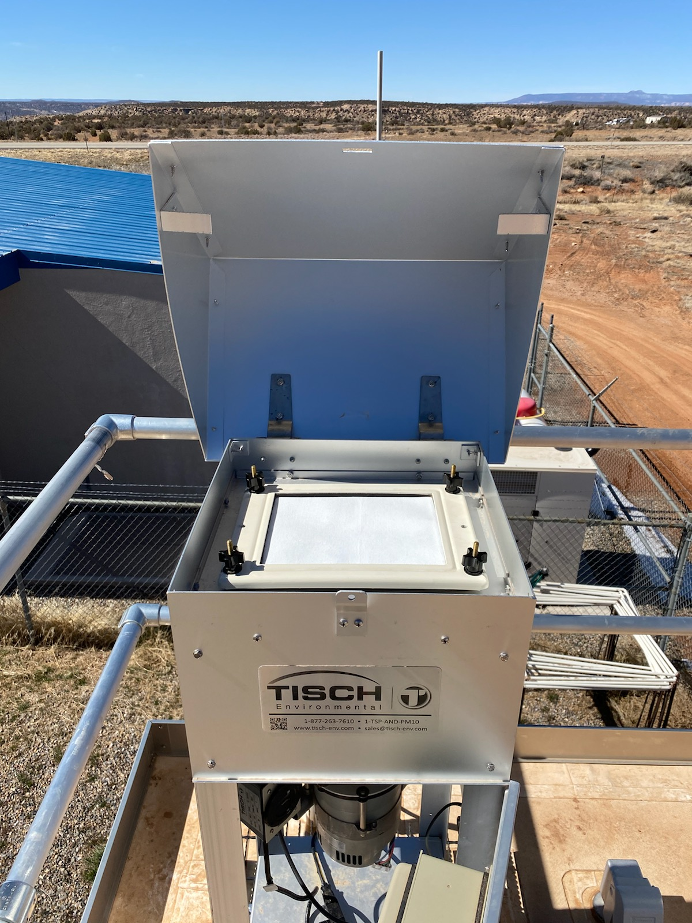
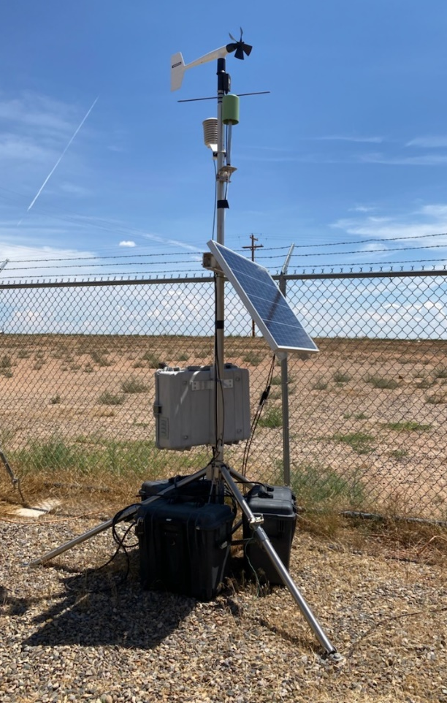
UMUT Air Quality – White Mesa
Tisch High Volume Total Suspended Particulate Monitor–Filter based
Filters are sent to lab to measure radioactive components
Portable Ozone Monitoring System (POMS); Solar powered small ozone analyzer and meteorological instruments
- A stand alone system

Slide 9
UMUT Air Quality
Low Cost Sensors (Purple Air)
Towaoc and White Mesa
Headstart at Towaoc
Planning for more sensors under the EJ Grant at White Mesa as a Citizen Science component

Slide 10
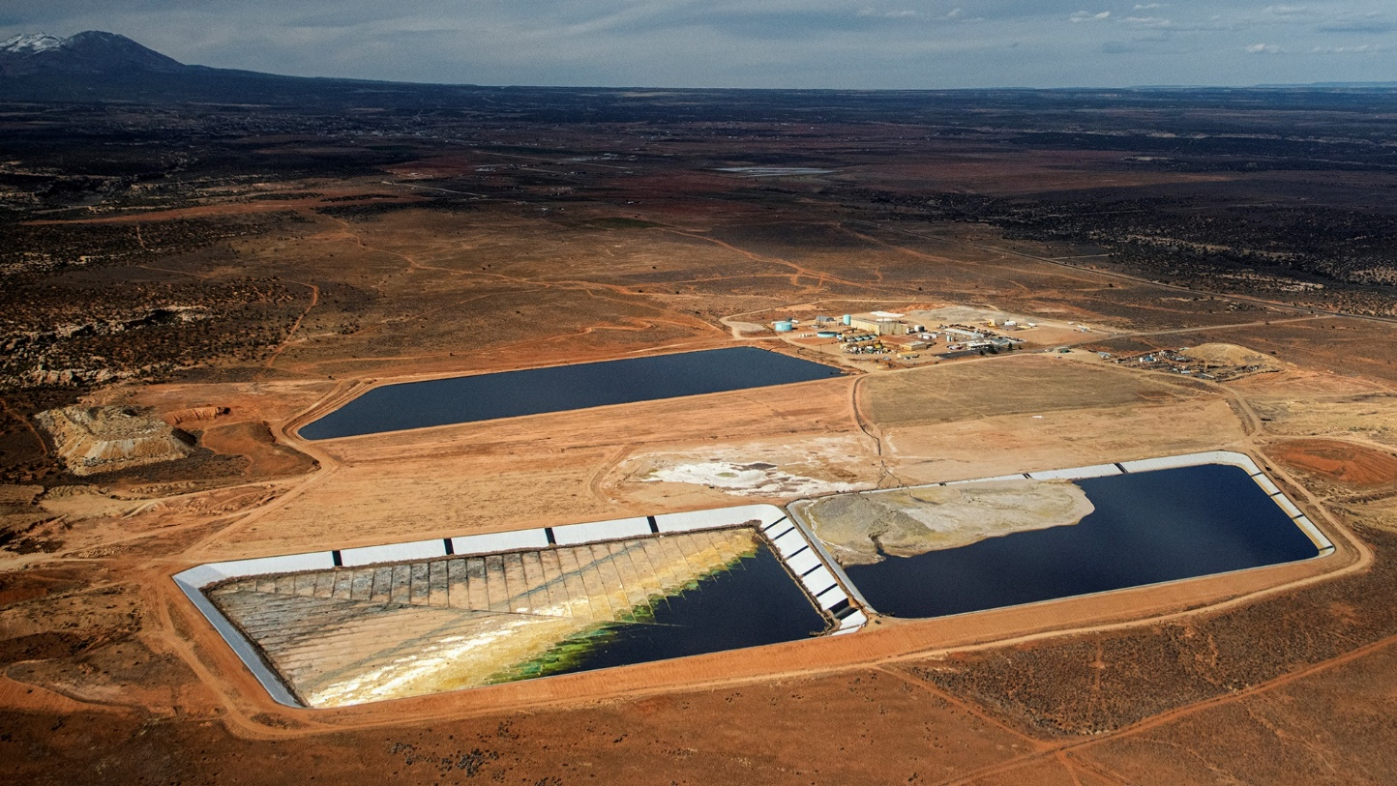
UMUT EJ Grant Work – focused on White Mesa Community
Members of the White Mesa Community have a history of concerns with the uranium mill and can ‘smell’ the off gases. In 2012, one of the community members took this photo of the mill.
Radioactive sources from all over the world, e.g., Japan and Estonia are scheduled to be disposed in the Tribe’s backyard.
Notes:
Feel free to change slide headings and so forth

Slide 11
UMUT EJ and Air Quality work and TEMPO Datasets
TEMPO datasets that UMUT potential to use | Sources?
PM 2.5 | White Mesa Mill/Industry/Vehicles
NOx | White Mesa Mill/Industry/Vehicles
Ozone | Oil and Gas
SOx | Oil and Gas/Industry
Formaldehyde | Oil and Gas/Industrial VOCs
Glyoxal | Oil and Gas/Industrial VOCs
Fire/hotspot | Wildfires- overall safety
Aside from Radioactivity Concerns from White Mesa Mill, is the White Mesa Community Influenced by other pollutants?
TEMPO datasets could assist:
Notes:
Feel free to change slide headings and so forth

Slide 12
UMUT Air Quality Program- The data and tools we use
Data and Tools:
Monitor data (pollutants and meteorology)
QREST – Tribal Air Database
Use of neighboring data (Southern Ute Indian Tribe/Mesa Verde National Park; review data from WM Uranium Mill)
GIS
TEISS – Tribal Emissions Inventory Program
Institute of Tribal Environmental Professionals and Tribal Air Monitoring Support - provide data/resources upon request
EPA codes/data – EPA Air Quality Systems (pipe delimited format) data can be converted inside or outside database
AirNow – EPA, Fire and Smoke map
EPA databases – spreadsheet compatible
National Forest Service Map – Active Fire Mapping Program (make observations) (fsapps.nwcg.gov)
Notes:
Feel free to change slide headings and so forth

Slide 13
UMUT –Air Quality: Using new data--the process
Decisions about datasets are usually made by the program manager with guidance from the Tribal leaders and upper management.
We use desk/laptop computer programs.
Data is in a .csv format and compatible with familiar spreadsheet programs e.g., MS Excel.
GIS compatible formats (shapefiles).
We may need training on what and how to integrate the data. (We have support for technical aspects through Institute of Tribal Environmental Professionals and Tribal Air Monitoring Support with some forms of data.)
For processing we have experience using R-Code and OpenRefine (open source).
Notes:
Feel free to change slide headings and so forth

